Slide 1
Eco Bike Rental
Group 5

Slide 2
Members in group
Nguyen Thai An
Vu Minh Hoang
Bui Tu Hoang
Nguyen Manh Khang

Slide 3
Contents
Interaction Diagram
Class Diagram
Design

Slide 4
Interaction Diagram

Slide 5
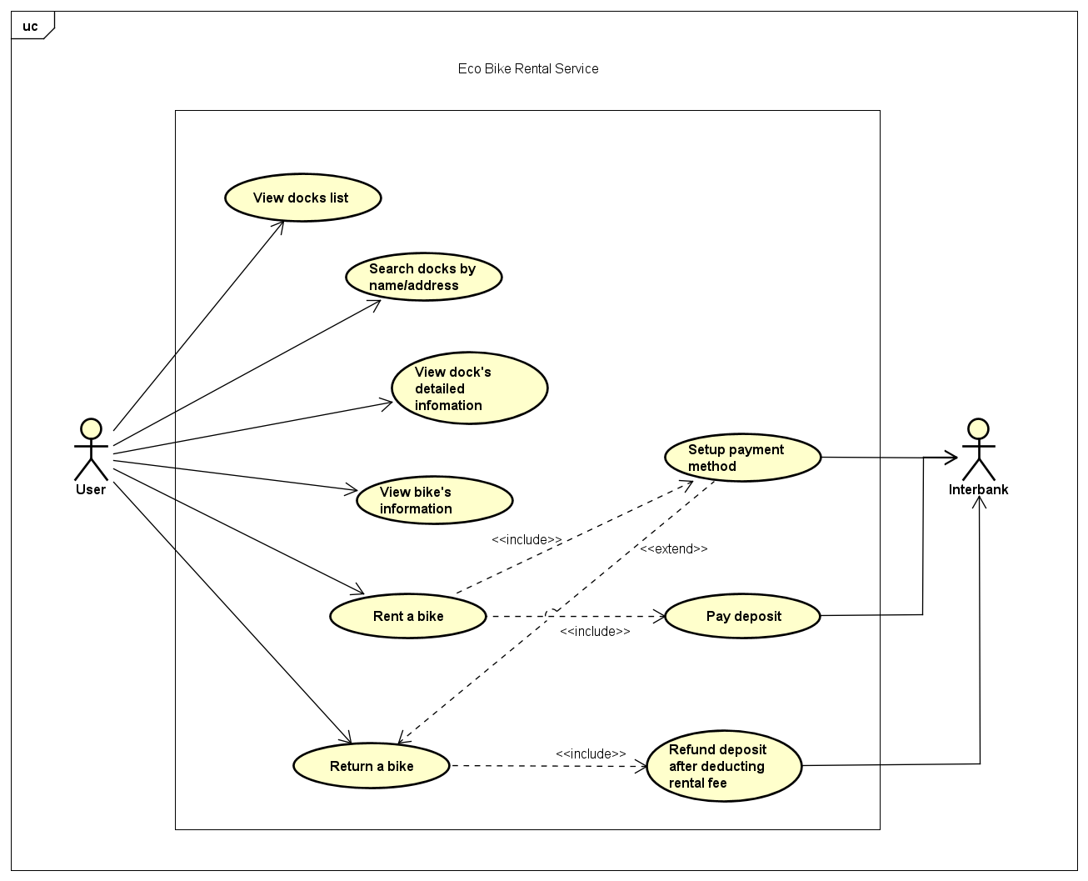
EBR use case diagram

Slide 6
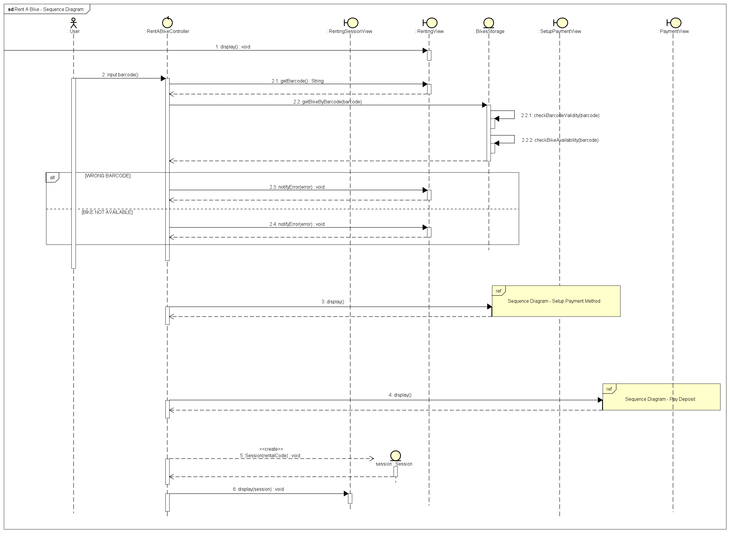
Interaction Diagram – Rent a bike

Slide 7
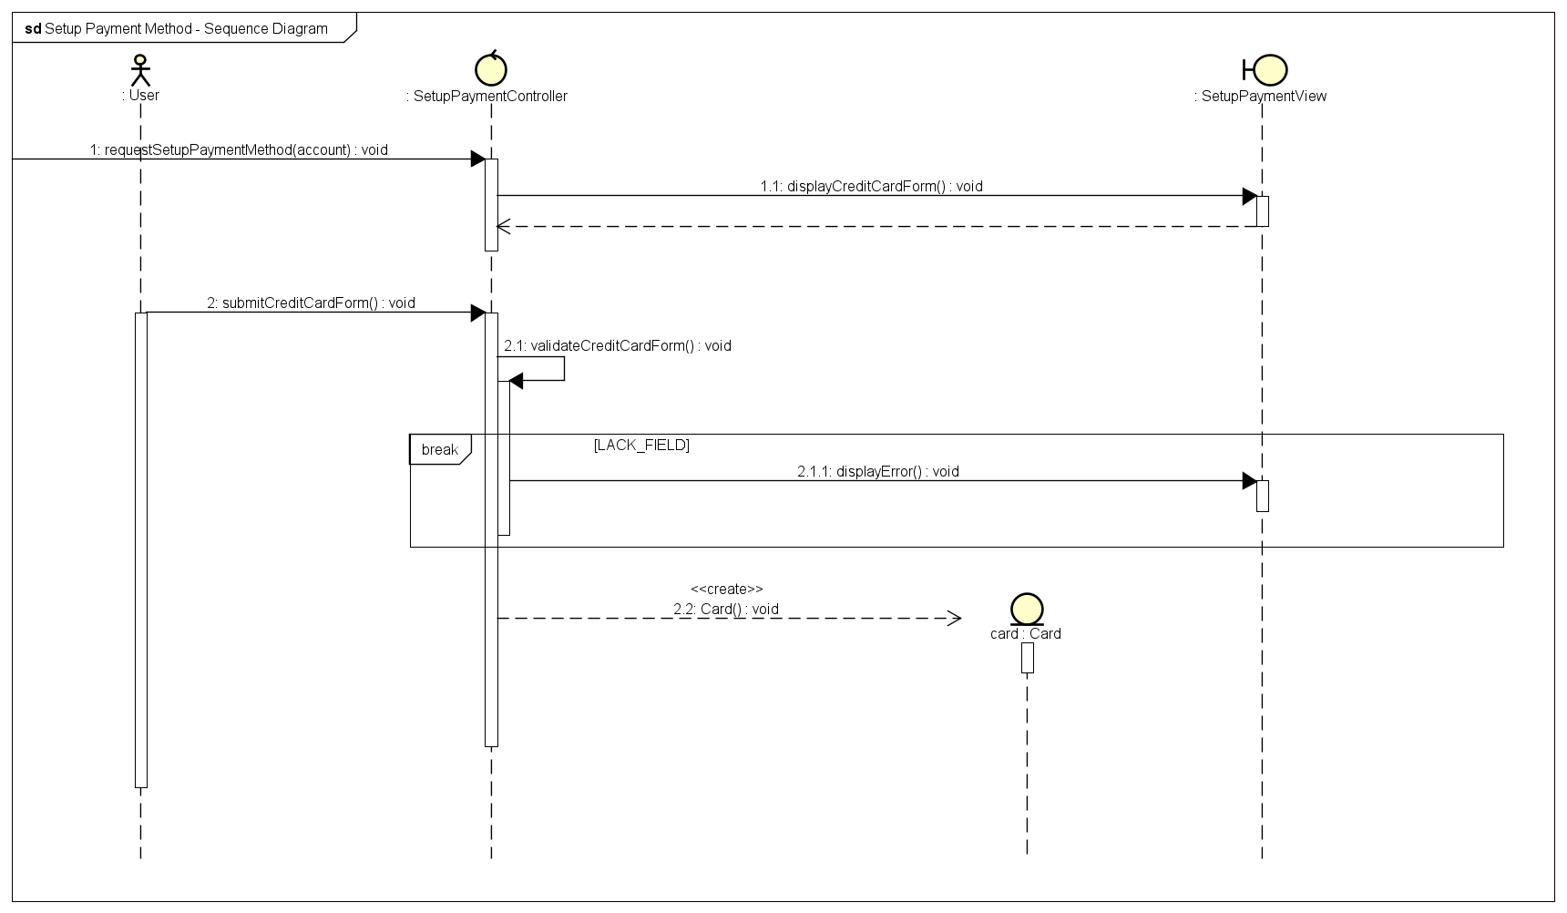
Interaction Diagram – Setup Payment Method

Slide 8
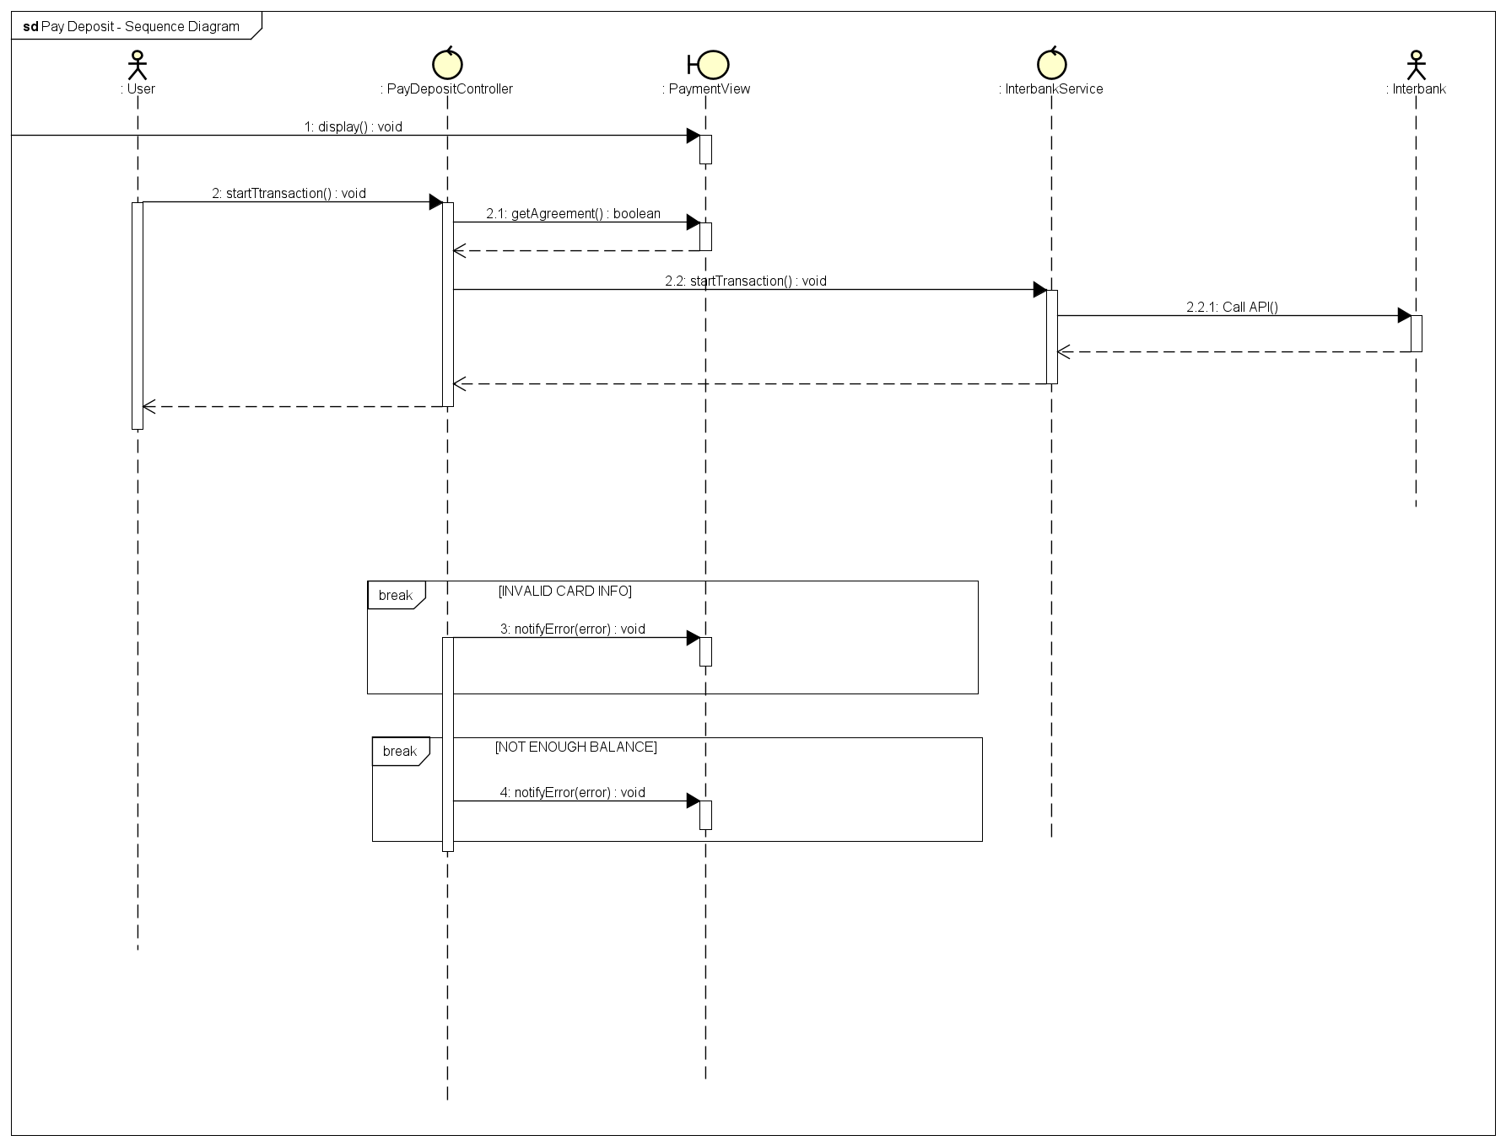
Interaction Diagram – Pay Deposit

Slide 9
Class Diagram

Slide 10
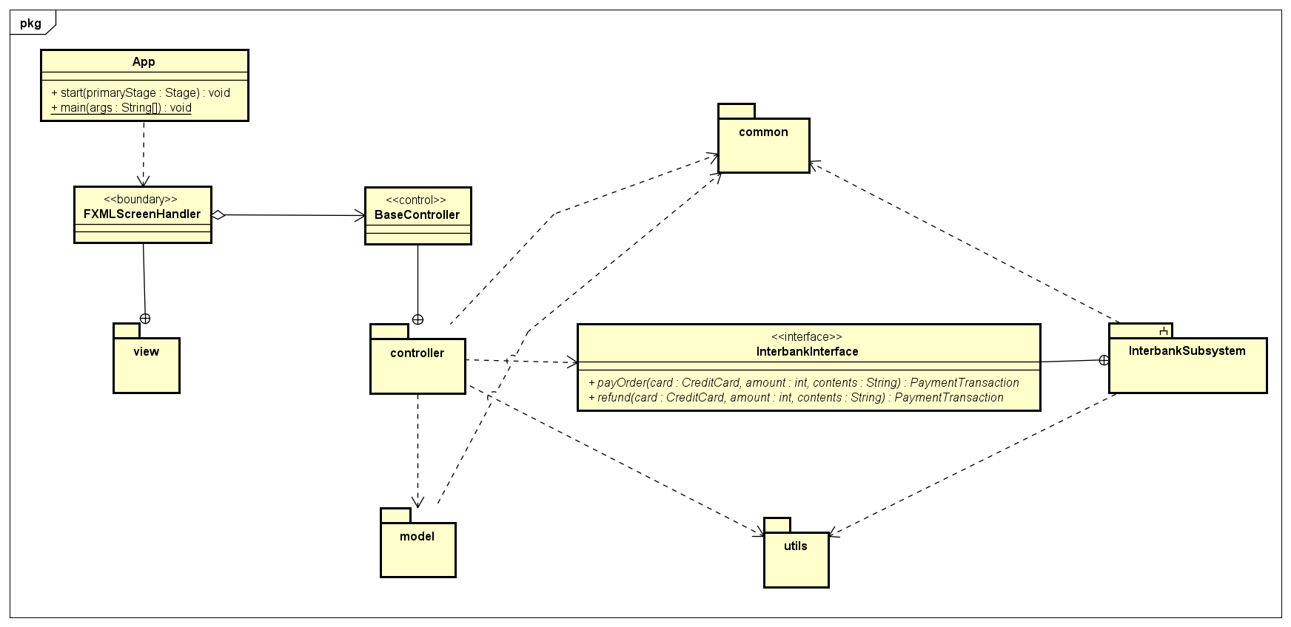
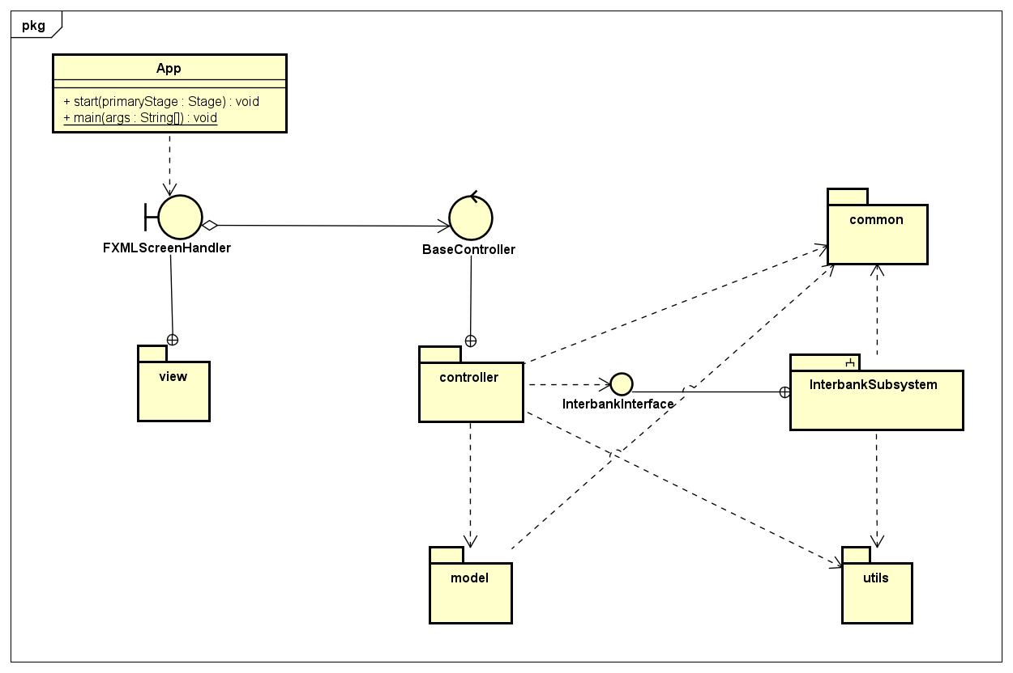
Class Diagram - App

Slide 11
Class diagram – Controller

Slide 12
Class diagram – Model

Slide 13
Class diagram – View

Slide 14
Class diagram – Utils

Slide 15
Class diagram – Interbank

Slide 16
Design Considerations

Slide 17
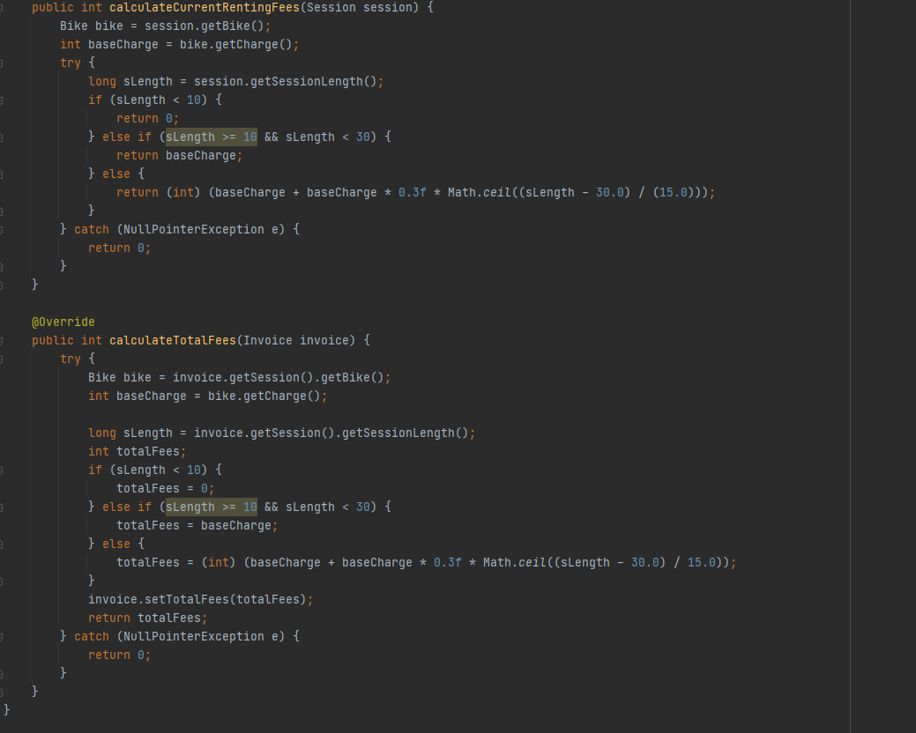
Design Concepts
Coupling
There are no coupling issues at Content, Common and Control level.
Most of our classes and packages are at Data Coupling level, which is already a good design.
There some parts of design are at Stamp Coupling level, but all are acceptable.

Slide 18
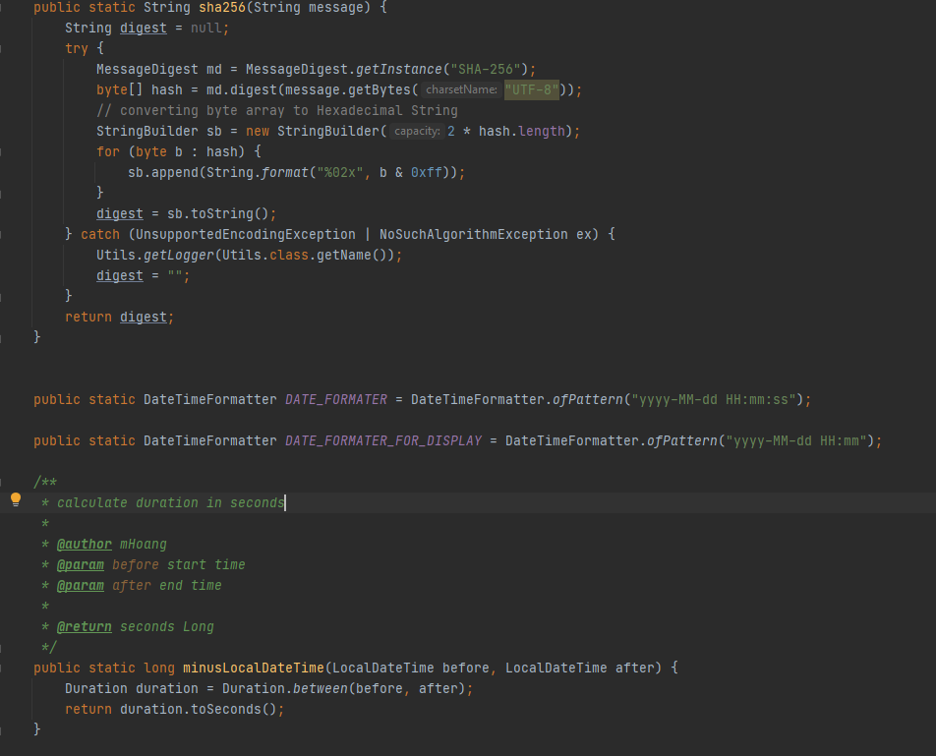
Design Concepts
Coupling
Cohesion
There are no coupling issues at Content, Common and Control level.
Most of our classes and packages are at Data Coupling level, which is already a good design.
There some parts of design are at Stamp Coupling level, but all are acceptable.
There is no component with Cohesion issues at Coincidental, Temporal, Procedural and Communicational level.
There’s an exception in utility class Utils: it contains method for both security methods (hash) and formatting methods (time, date, …). However, all those methods are static, and this class acts only as helper/utility.

Slide 19
Design Principles
Single Responsibility Principle:
Each of our designed classes follows this principle.
Only exception is the Utils class as it contains method for both security and formatting.
Open / Closed Principle:
Use Strategy Pattern to solve requirement of extending multiple renting fees formulas.
Design also has many parent classes to use for generalization (e.g., StandardBike and StandardElecticalBike for adding new kind of bike, PaymentCard for adding new payment method, …)

Slide 20
Design Principles
Liskov Substitution Principle
All the parent class can be substituted by its children classes.
Design has a clear and logical inheritance hierarchy.
Interface Segregation Principle
Simply Interbank System Interface.
Contains only 2 methods that needed for pay and refund.
Dependency Inversion Principle
Higher-level modules do not depend on lower-level modules.
All subsystem has their own interface for other to use.
Extends Payment Class to add more card type.

Slide 21
Design Patterns
Singleton:
Use Singleton Pattern to design all manager model classes
For example, the DockManager class will store all queried docks for displaying, reading data.
Strategy:
Solve the violation of Open/Closed Principle.
For example, of implementation, the design uses this pattern in renting fee calculation by making a parent abstract class RentingFeeCalculator then let others type of Calculator extends it.

Slide 22
Design Patterns
Façade:
This pattern is used to reduce complexity of API of a service or interface of a subsystem.
The current design applies this pattern on the interbank subsystem, to make it interface simple and compact.

